Slide 1

ACTION PLANS – IDEAS & CHALLENGES IN IMPLEMENTATION
Norosoa RAZANAJATOVO, PhD, NIC - Technical Officer
Tsiry RANDRIAMBOLAMANANTSOA, MSc, NIC - Research Engineer
Claudio RAHARINANDRASANA, MSc, NIC - Research Engineer

Slide 2

Current situation
Existing respiratory surveillance systems
Influenza sentinel surveillance
COVID-19 diagnostic and response capacity
RSV surveillance
Diagnostic capacity
PCR
Cell culture
Serology
Sequencing capacity
Illumina (Iseq100, MiniSeq)
ONT ( MinION)

Slide 3
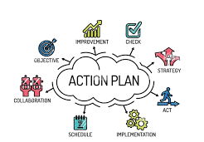
Proposed action plan (1)
In country:
Reinforce in-country surveillance capacity
(e.g. samples and data collection/quality, etc…)
Include potential emerging viruses in routine testing (e.g. routine testing of RSV in ILI samples, HMPV-ILI and SARI)
Through this network:
Expand sequencing capacity and bioinformatics skills
Standardize sequencing protocols/workflow

Slide 4
Proposed action plan (2)
Standardize pipeline of analysis
(e.g. RSV-GenoScan, etc…) – If CLI, sharing script in cloud.
Develop capacity buildings for staff
(diagnostic, sequencing, bioinformatics, data managment, data sharing…)
Develop exchange programs within the network or with other institutions
Build/increase capacity for zoonotic surveillance

Slide 5
Proposed action plan (3)
Develop research programs within
the network or with other institutions
Conduct periodic communications with this networks
Develop a legal framework for data governance and sharing.

Slide 6

Challenges (1)
Locally
Obtain representative data and samples
Limited funding for sequencing capacity (equipment, reagents - if renew needed), IT equipment, and staff
Few trained technicians and lab scientists
Unstable power and internet connectivity
Notes:
So we need to secury fund

Slide 7
Challenges (2)
External
Different levels of knowledge and capacity (equipment and staff)
Different administrative and procurement procedures
Surveillance système depending on the specific contries objective
Divergent laws on data privacy and protection

Slide 8
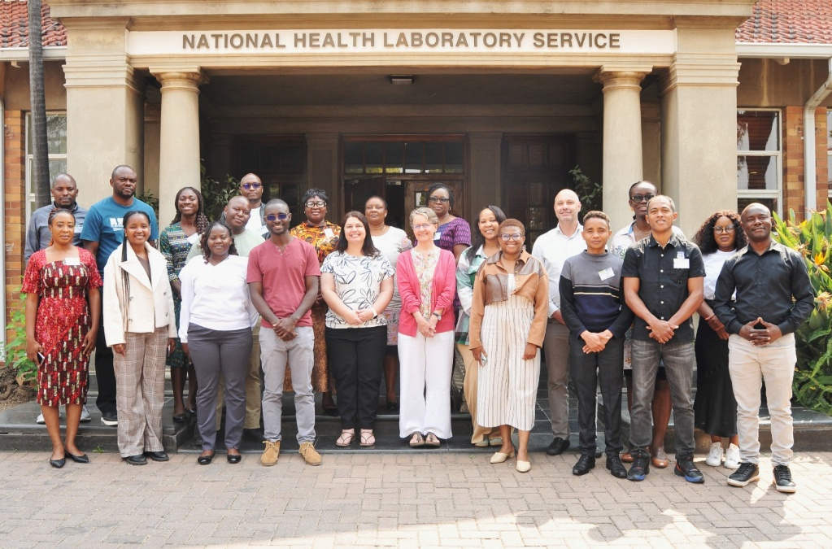


Proposed names
Respiratory Virus Network Africa (ReViNA)

Slide 9
